Slide 1
The STAGES Model of Adult Development
Patterns of Developing Maturity

Slide 2
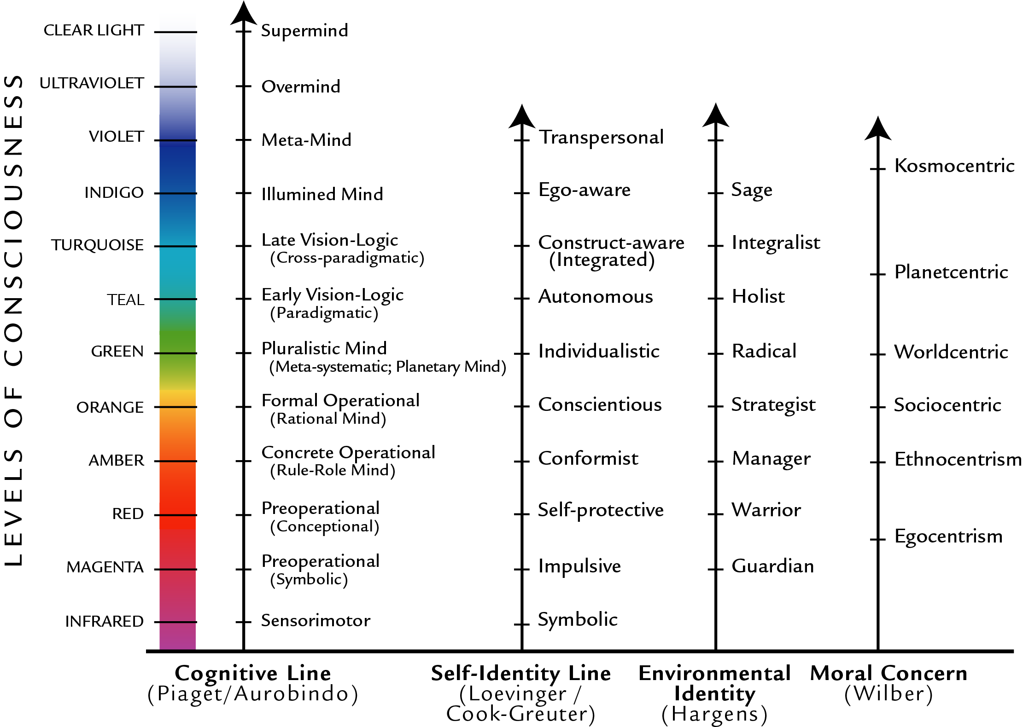
Growing up is a lifelong endeavor
We develop our capacity for
Increasingly zoomed out
person perspectives
Ever more sophisticated
meaning making
through many
Lines of development
Which share a similar
developmental sequence

Slide 3
Multiple models compared

Slide 4
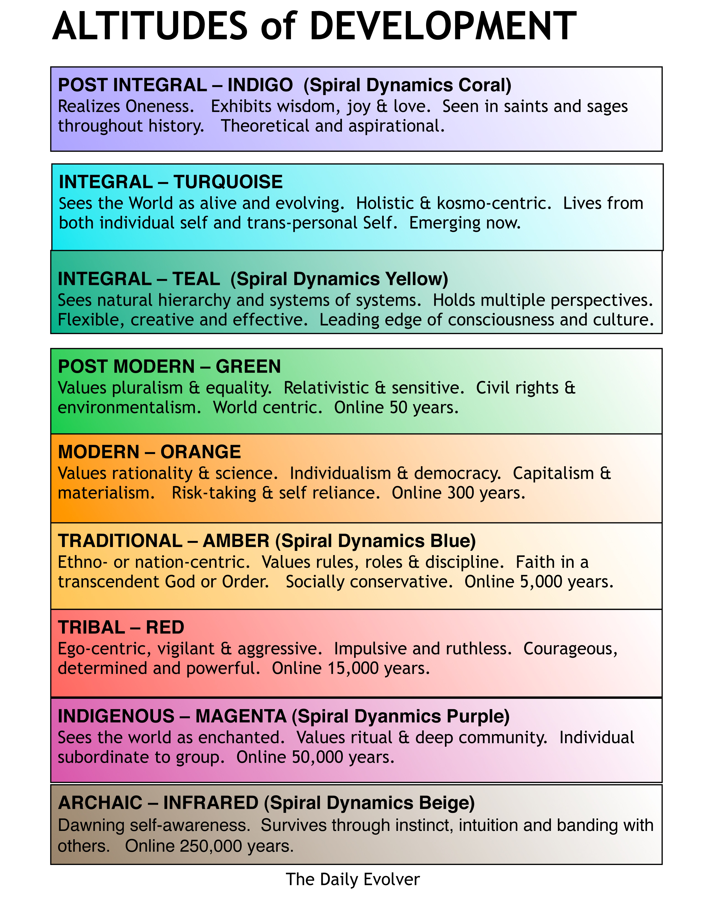
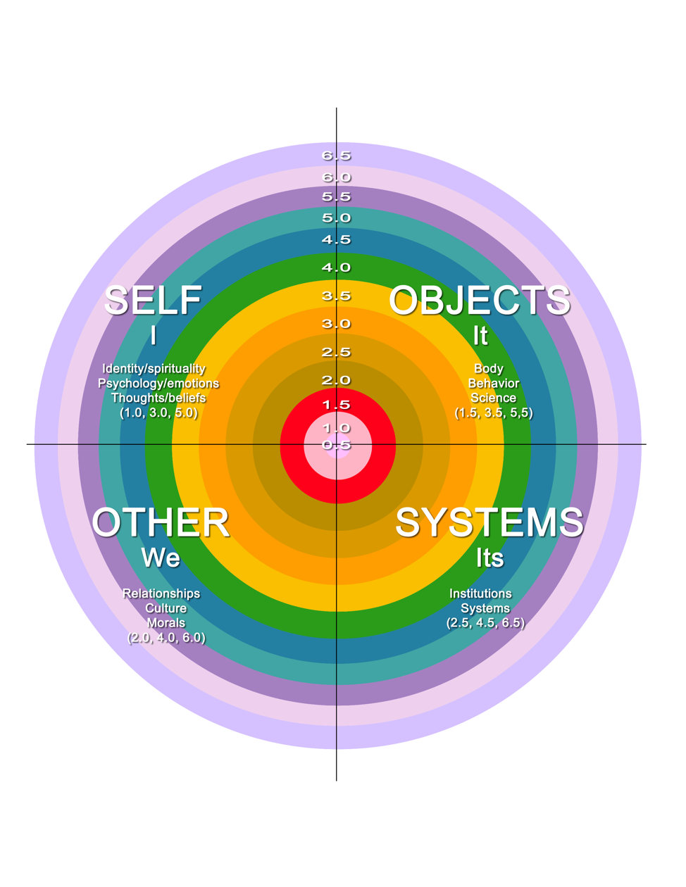
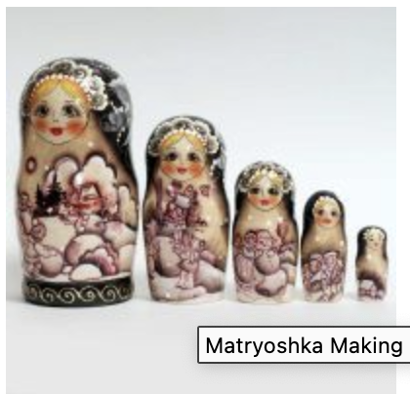
Ways of seeing
Lines vs center of gravity
Grasshopper, caterpillar
Ladders, Circles, and Nesting Dolls

Slide 5
How does growth happen?
Meaning making expands and deepens usually through openness, disorienting dilemmas, state practices, intention, study, etc.
Transcend and include previous stages
Caterpillar not grasshopper
How long does it take? Time, age
Individual, cultural development – pull of gravity
Why doesn’t everyone know about this? Objections to stages

Slide 6
Transformation vs. Translation Lines and stages: horizontal and vertical development

Slide 7
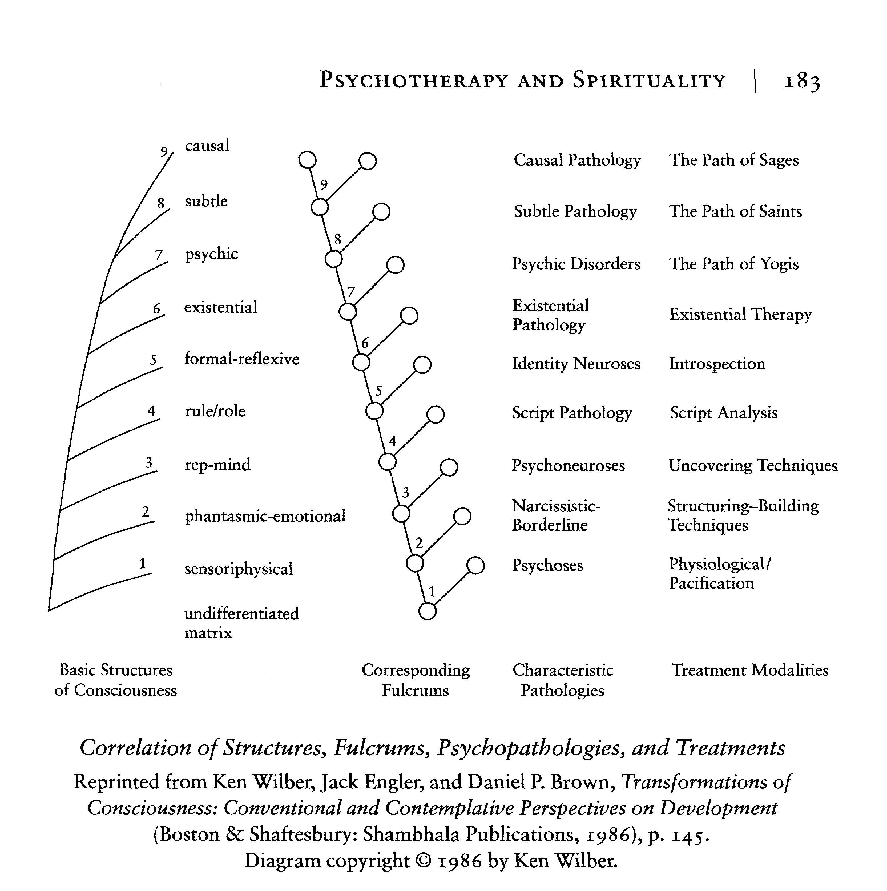
Wilber – early stage model
Spirit on top – early Ken Wilber
from Adi Da, later also in
The Religion of Tomorrow

Slide 8
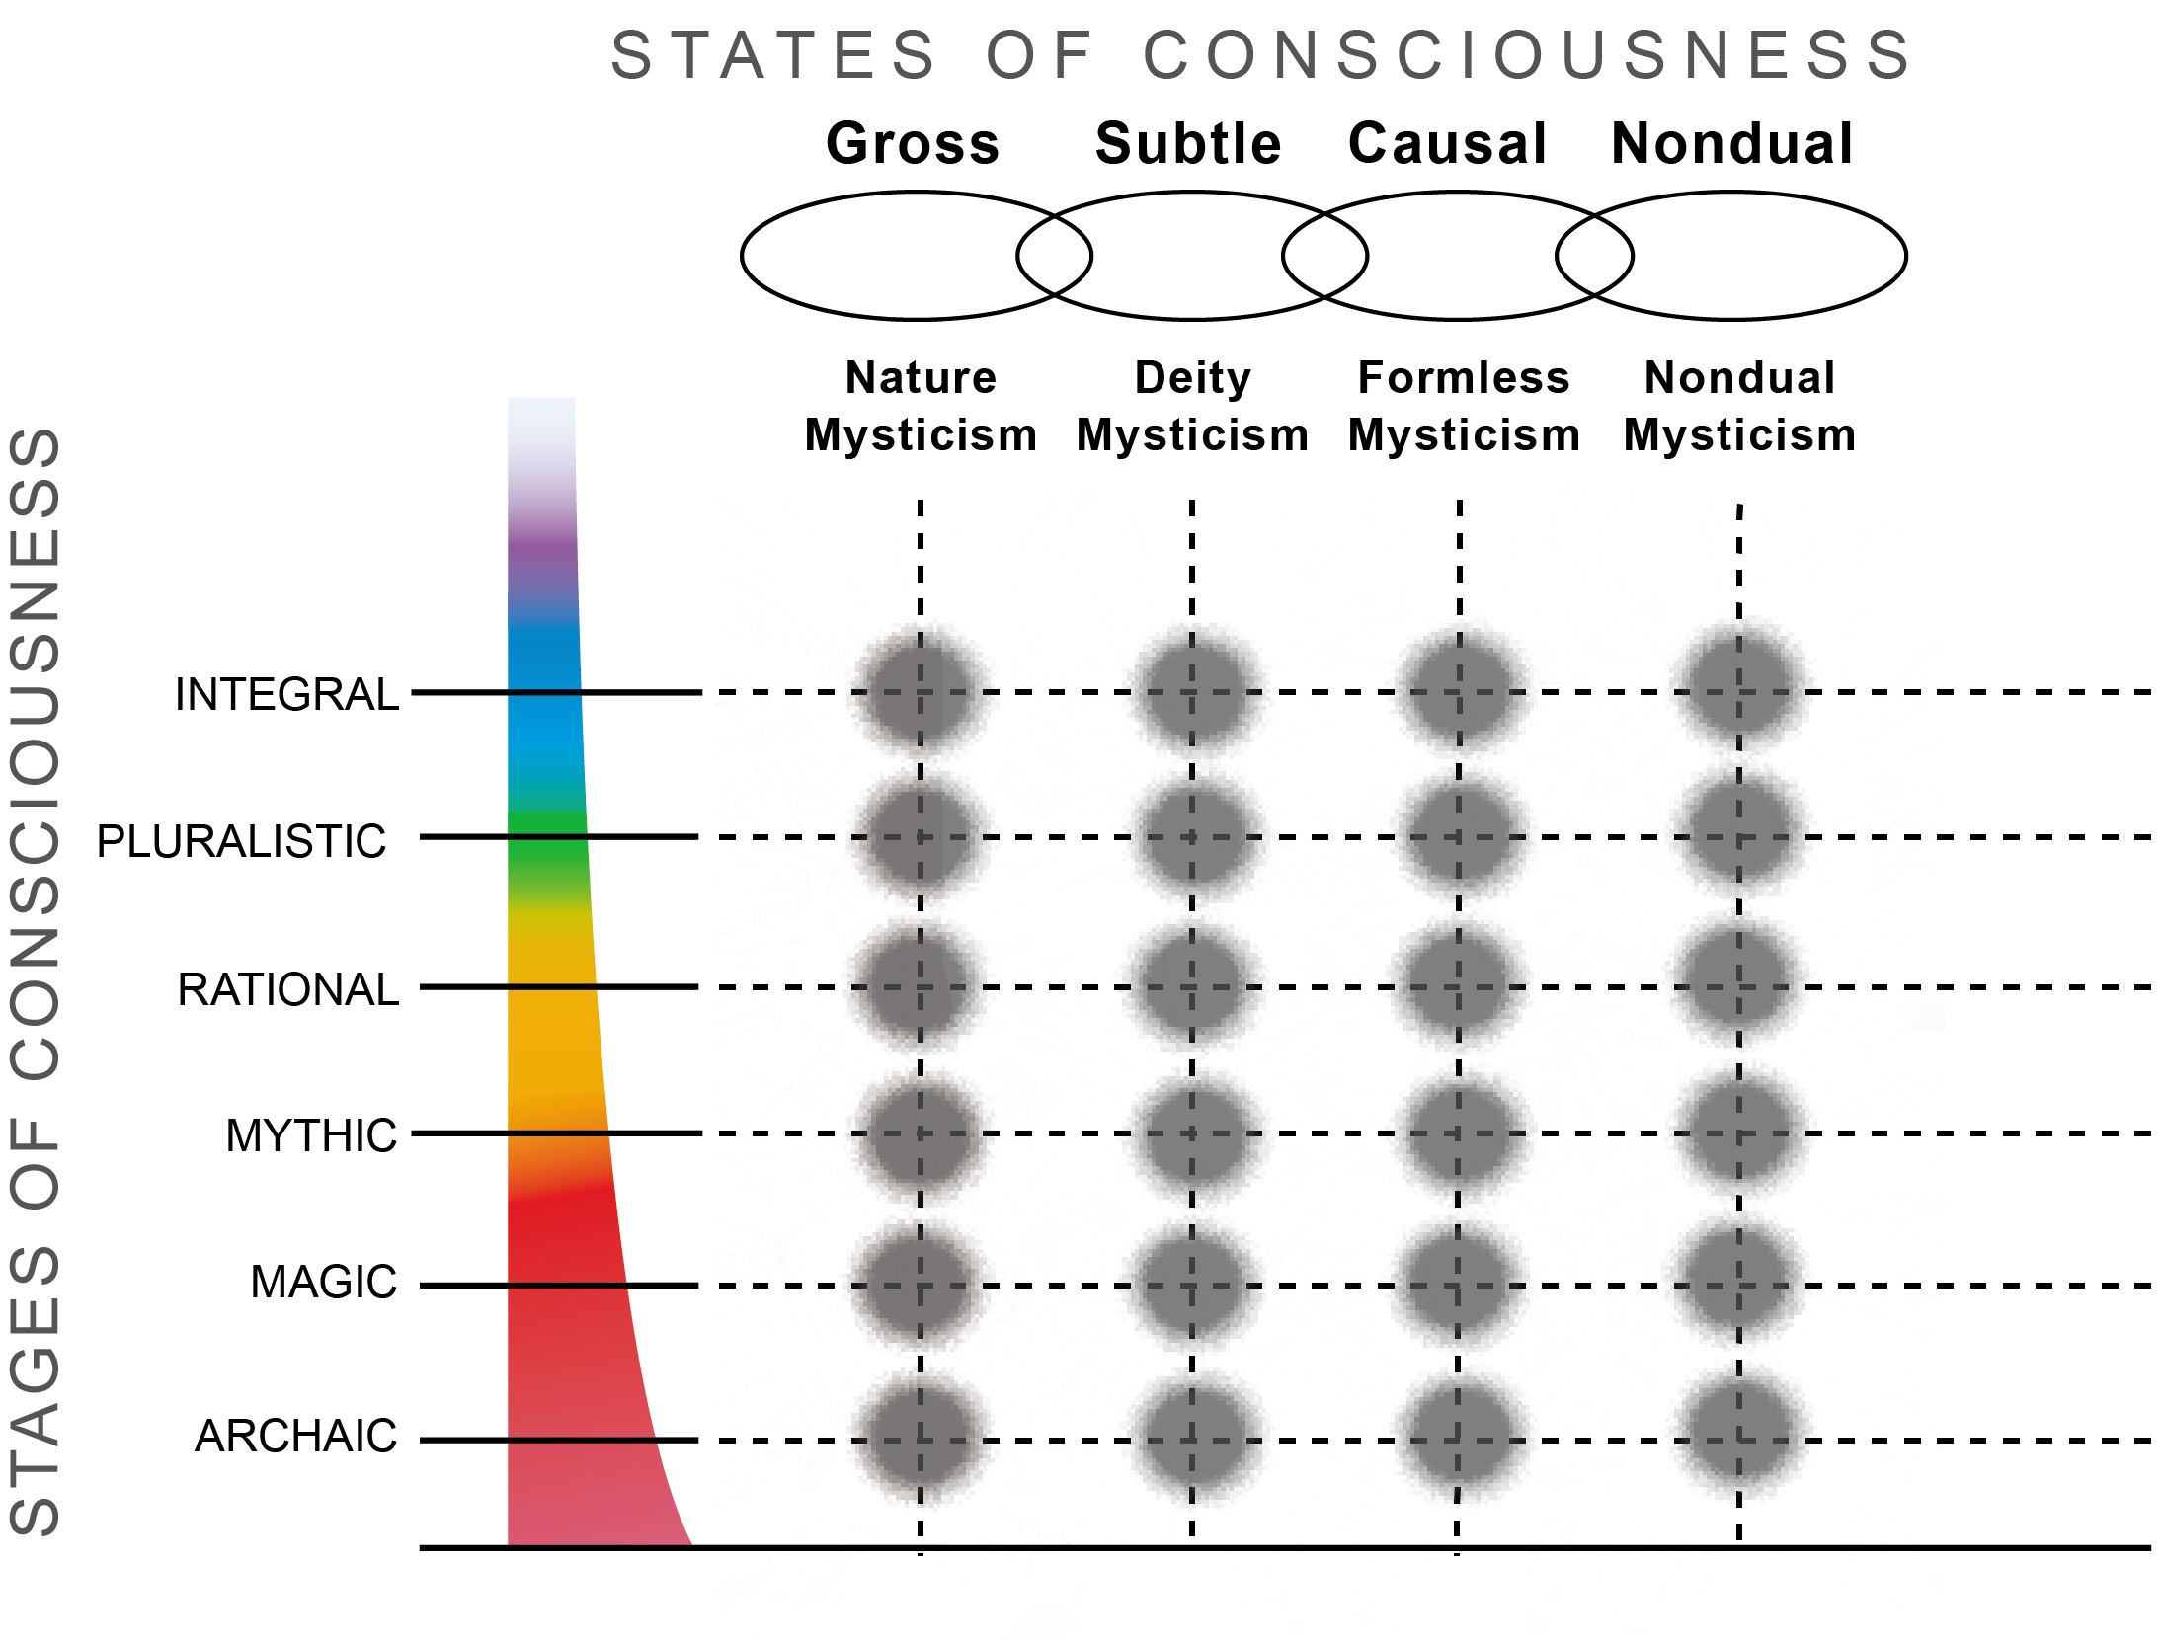
States and Stages
Spirit on a different axis –
Ken Wilber, Alan Combs

Slide 9
Stages and Stages
Spirit intertwined – Terri O’Fallon
First Tier
Capacity for visualization
Second Tier
Capacity for subtle awareness
Third Tier
Capacity for awareness of awareness

Slide 10
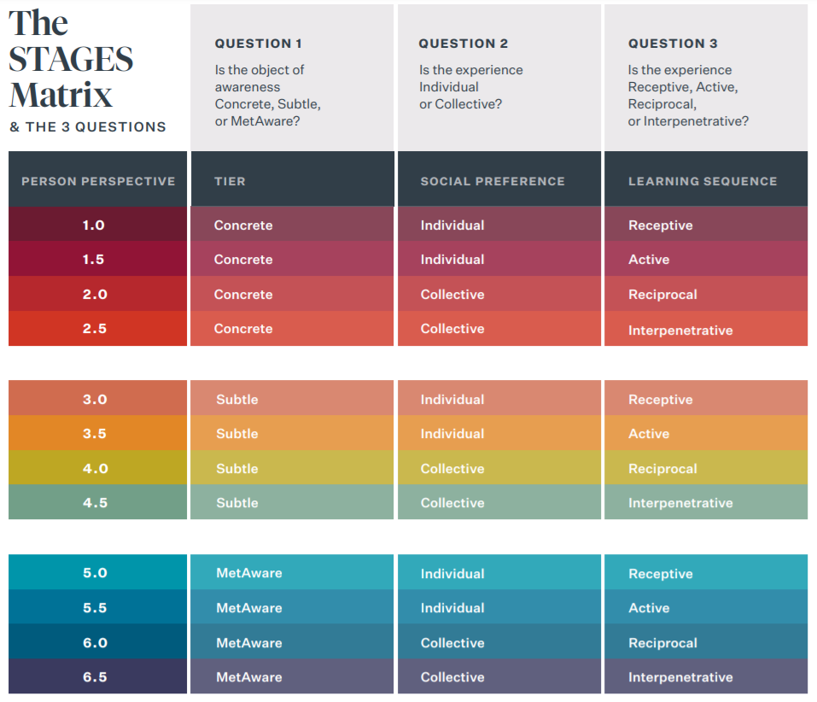
The basic scheme
Tiers each with four stages
Iterating patterns
Three questions

Slide 11
Terri O’Fallon STAGES model
Built on KW, Susann Cook-Greuter, Aurobindo, etc.
More granular
Higher levels researched
Person perspective - numbers

Slide 12
Matrix with Names

Slide 13
The basic scheme
Tiers each with four stages
Iterating patterns
Three questions

Slide 14
Stage Descriptions: Concrete Tier. Focus on Concrete Objects
Concrete
1.0 Impulsive, first person receptive. Need to develop basic trust and bond with parents. Copy others, learn their body
1.5 Egocentric, first person, action oriented – get what you want. Exploring power in the world: autonomy, initiative, follow-through, completion, celebration in the physical intellectual, emotional, and social areas. Either/or seeing.
2.0 Rule-Oriented second person – I see you see me. Shyness can arise. Relativity of concrete objects – e.g. beaker of different height same volume. This perception leads to equality, fairness, conformity. Can remember the past and learn from it. Hard to remember the rules. Can’t prioritize easily. Making friends, talking “with.”
2.5 Conformist second person. Begin to prioritize rules, become excessively agreeable to preserve status in a group, tend to not question authority or question norms, policy, etc. Interpenetration with their circle – I am you, you are me. Late 2.5 establishes principles which underlie rules so they become more stable. Can rebel against violations of these core principles. In group and out group.

Slide 15
Discussion
Offer examples or one or more of the concrete stages (from your own life or another life you are familiar with). Great to have children and adult examples.
How did you see yourself; how did you see others; what mattered to you/what did you value?

Slide 16
Stage Descriptions: Subtle Tier – focus on subtle objects
3.0 Expert 3d person. Individual focus, aware of own uniqueness. Fear of leaving the 2.5 group. Can visualize things not seen. Copies subtle experts. Look for “the answer.” Perfectionist, focus on detail. 2-3 year time span
3.5 Achiever 3d person. Can focus, self generate goals and visualize the future. Can prioritize subtle ideas. Strategic, metacognitive. 80/20 rule. Science is the answer to human perfectibility. Engage in skill building. Copy social skills, arguments, emotional control of other successful people. Resent goals being interfered with.
4.0 Pluralist 4th person. See and seen in subtle. Want to discover their real subtle self – need others to help them gain awareness of assumptions, interpretations, judgments and that others see in them. Everything is relative, contextual, life is more ambiguous. Collective consciousness is noticed, relationship is emphasized over goal orientation. Allergy to Achievers. 3 generations time span. From roles to archetypes. Respect and protect dignity of everyone.
4.5 Strategist 4th person. Prioritize developmental, people oriented, developmentally inclusive perspectives which foster continuous learning. See value of all levels. Can stand outside systems and thus construct them instead of being constructed by them. Recognize projections on reflection. Time frame is past and future generations. Zoom in (focus) and out (awareness). Embrace paradox. Authenticity over niceness. See patterns of the human mind. Internal and external systems view. Can create internal system that leads to sustainable peace of mind, not just temporary. Compassion for mistakes of earlier stages.

Slide 17
Discussion of subtle
Offer examples or one or more of the subtle stages (from your own life or another life you are familiar with).
How did you see yourself; how did you see others; what mattered to you/what did you value?

Slide 18
Stage Descriptions. Metaware Tier. Focus on Metaware Objects
5.0 Construct Aware – 5th person. Historic time frame, cosmic space frame. Awareness as identity, observing self and objects within it. Begin to disidentify with subtle ego. Witnessing in the moment. See how we reify and concretize our individual constructions and stories through language and assumed definitions and boundaries. Can turn things inside out, upside down in unusual ways. From social construction to individual construction – all created by the mind. Difficult transition. Disorientation, changes.
5.5 Transpersonal – 5th person. They can develop these metaware constructions. Burned out on being taught. Don’t feel deeply seen by others. Meta model building around a passion. Aware of subtle ego. Witnessing in the moment. Identify with Awareness.
6.0 Universal – 6th person. Surrender individual to the Metaware Collective. Unification with whole Universe. Integrating fullness and emptiness. All at once wholes. Poetic. Universal love/compassion without an object. Deep appreciation for all.
6.5 Illumined. Interpenetration of fullness and emptiness, one within the other. Able to reflect on the Universal oceanic experience. See projections of entire world of mind on matter and life. Can prioritize different universes created by Mind. Capacity for Meta Visions that encompass and describe one Whole. Integrates concrete, subtle and causal. Has instead of being had by.

Slide 19
What stage am I: How to Know?
Formal assessment – the best way
Stages https://www.stagesinternational.com/stagesassessments
MAP: https://www.bbraham.com/maturity_assessment_profile.html
Lectica LDMA https://lecticalive.org/about/ldma#gsc.tab=0
Avoid the tendency to rate self higher (Robb Smith says most people think they are two stages ahead of where they are)
Sequential nature – if lower levels aren’t filled out, may be state development over stage.
Prompts are comprehensive and designed to elicit necessary information
Reviewed by a trained scorer (often years of training)
Part of an overall scheme in which various elements that research shows are related to certain levels.
You get detailed information and recommendations.
But, it’s expensive.

Slide 20
Self Assessment
Method A
1. Find a discussion of the stages (KW book, Susann’s paper, Terri’s model)
2. Write out answers to these and any more areas you can think of
A. your values
B. your preferences for doing and experiencing
B. What is good and bad about the world today.
C. The qualities of people you prefer to be around
D. The qualities of people you prefer not to be around
Review the stage discussion.
In what stage would your values fall, your preferences, your worldview, the qualities you mention, your worldview? Those you dislike are likely to be below or above your stage.

Slide 21
Self Assessment
Method B - longer
1. Study a description of the stages
2. For each stage write about yourself in that stage. Include your beliefs, your actions, your preferences, your worldview, your values, your relationships, and so on. Give examples as to why you included these in this stage. [Include your ages, note the bell curve - you may begin a stage at 2 and still be acting out of it at 18, or begin a stage at 14 and still be acting out of it at 40.]
3. Include as many domains as seem relevant
4. Stop when it becomes difficult to complete this exercise. That is where you are now.

Slide 22
Practices for transformation
The unappealing ones are likely to be just what you need.
Your reaction to them may also help you to assess your stage.
The number one practice for transformation is translation into multiple areas where you are now until your cup overfloweth.
Others include spiritual practice, an attitude of openness, working with disorienting dilemmas, practicing quadrant seeing/stages seeing, looking for allergies and addictions (KW course Full Spectrum Awareness)

Slide 23
Recommendations for each stage
2.5 – 3.0 Question family, religious, other truths; study multiple opinions on any subject; notice where you are different from the groups you are a part of.
3.0 – 3.5 Create plans for the future; select an area in which you want to achieve and be responsible about pursuing it; become aware of your own feelings and thoughts (metacognition); engage with multiple views of a subject through feedback processes; engage in scientific analysis.
3.5 – 4.0 Notice the circumstances/contexts in which things take place; in gatherings, notice if all voices are being heard; investigate your interior feelings and thoughts, especially your parts; share your interiors with others; notice how you and others are socially constructed.
4.0 - 4.5 Learn about adult development; notice it in action; notice and name contexts; notice your projections on others; consider how to create systems in which others thrive.
4.5– 5.0 Question the truth of what you think; take back projections; question the solidity and stability of societal constructions;
5.0 – 5.5 Notice when you are reifying a construction; notice the emptiness of words and definitions; experiment with shifting boundaries (e.g. integral inclusiveness); notice the subtle ego
5.5 - 6.0 Sink in and empty out; take time to just be; notice the felt difference between emptiness and immanence; consider the relationship of past, future, and now. Notice the personal self from the perspective of the Witness.

Slide 24
Brief Overview

Slide 25
Matrix with Names

Slide 26
The basic scheme
Tiers each with four stages
Iterating patterns
Three questions

